Slide 1
University Admit Eligibility Predictor
Domain: Applied Data Science
SRIVATSAN R, SHARAN U, SANJAYKUMAR M, THAMIZH DASAN K

Slide 2
Project Abstract
Students are often worried about their chances of admission to University. The aim of this project is to help students in shortlisting universities with their profiles. The predicted output gives them a fair idea about their admission chances in a particular university. This analysis should also help students who are currently preparing or will be preparing to get a better idea.

Slide 3
Project Objectives
To Understand:
Regression and Classification Problems
To grab insights from data through visualization.
Applying different ML algorithms accordingly
Evaluation metrics
Build a web application using the Flask framework.

Slide 4
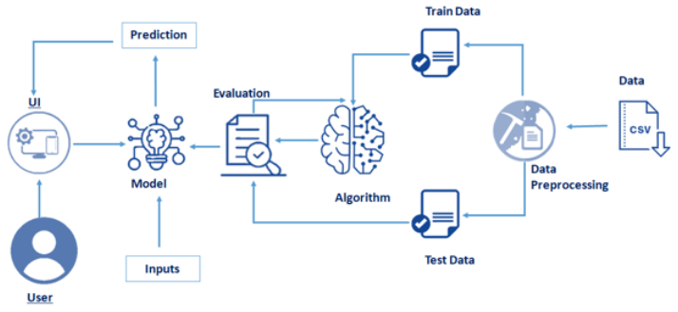
Architecture Diagram

Slide 5
Literature Survey
1) “Graduate Admission Prediction Using Machine Learning”,
research paper by Sara Aljasmi, Ali Bou Nassif, Ismail Shahin, Ashraf Elnagar.
Abstract:
Student admission problem is very important in educational institutions. This paper addresses machine learning models to predict the chance of a student to be admitted to a master's program. This will assist students to know in advance if they have a chance to get accepted. The machine learning models are multiple linear regression, k-nearest neighbor, random forest, and Multilayer Perceptron. Experiments show that the Multilayer Perceptron model surpasses other models.
References: Aljasmi, S., Nassif, A.B., Shahin, I. and Elnagar, A., 2020. Graduate admission prediction using machine learning. Int. J. Comput. Commun, 14, pp.79-83.

Slide 6
Literature Survey
2) “HRSPCA: Hybrid recommender system for predicting college admission”,
research paper by Abdul Hamid M Ragab, Abdul Fatah S. Mashat, Ahmed M Khedra
Abstract:
This paper presents a new college admission system using hybrid recommender based on data mining techniques and knowledge discovery rules, for tackling college admissions prediction problems. This is due to the huge numbers of students required to attend university colleges every year. The proposed HRSPCA system consists of two cascaded hybrid recommenders working together with the help of college predictor, for achieving high performance.
References: A. H. M. Ragab, A. F. S. Mashat and A. M. Khedra, "HRSPCA: Hybrid recommender system for predicting college admission," 2012 12th International Conference on Intelligent Systems Design and Applications (ISDA), 2012, pp. 107-113, doi: 10.1109/ISDA.2012.6416521.

Slide 7
Literature Survey
3) University Admissions Predictor Using Logistic Regression
Research paper by Haseeba Fathiya and Lipsa Sadath
Abstract:
This is a novel study on a predictor for university admissions that allows students to assess their chances of being admitted to an institution. Real student data is gathered in order to construct this. The information is kept in the form of a training set that may be used by the logistic regression classifier that was designed to predict admissions.
References: H. Fathiya and L. Sadath, "University Admissions Predictor Using Logistic Regression," 2021 International Conference on Computational Intelligence and Knowledge Economy (ICCIKE), 2021, pp. 46-51, doi: 10.1109/ICCIKE51210.2021.9410717.

Slide 8
Literature Survey
4) A Machine Learning Approach for Graduate Admission Prediction
Research paper by Amal AlGhamdi, Amal Barsheed, Hanadi AlMshjary and Hanan AlGhamdi
Abstract:
This paper evaluates three learning strategies of regression to predict the university rate given the students' profile; namely, linear regression, decision tree, and logistic regression model. This paper evaluates, these models to select the best model in terms of the highest accuracy rate and the least error. It was determined that Logistic Regression model shows the most accurate prediction and hence this model was employed to predict the future applicant's university chance of admission.
References: AlGhamdi, A., Barsheed, A., AlMshjary, H. and AlGhamdi, H., 2020, March. A machine learning approach for graduate admission prediction. In Proceedings of the 2020 2nd International Conference on Image, Video and Signal Processing (pp. 155-158).

Slide 9
Literature Survey
5) Introduction to Modelling Tabular Data: Predicting a student’s chance of gaining admission using ML | by Jia Qing
Abstract:
This article uses the Graduate Admissions dataset (UCLA Admissions Dataset) and predicts a student’s chances of getting an admit into a US university using ML algorithms. It was concluded that Multiple Linear Regression was the best model for predicting the admission chances of a student.

Slide 10
Literature Survey
6) UNIVERSITY PREDICTOR by machine learning | by Jigar prajapati | Medium
Abstract:
This article talks about the architecture and algorithm of the system proposed. KNN, Decision Tree, and Logistic Regression were used to find the admits of a particular student. The ML models considers various parameters like GRE and TOEFL Score, SOP, LOR. Finally , upon evaluation, the author states that Decision Tree had the best accuracy out of the tree algorithms used.

Slide 11
Literature Survey
7) https://github.com/karanwadhwa/dd-admission-predictor
Abstract:
This system was originally developed only for Engineering College Admissions in Maharashtra,India but can essentially be adapted for other streams too. The purpose of it is to build a system to predict the user’s chances for getting into a certain college. The basic idea behind this project was to cross reference the user’s entered grades with the average of the past 3-5 years cut-off lists of the colleges and based on that the colleges with avg. cut-off list marks less than the users acquired grades were displayed.

Slide 12
Literature Survey
8) GitHub - satwik2663/Machine-Learning-Graduate-Studuent-Admission-Predictor: A machine learning model build to help student and universities after GRE exam
Abstract:
A machine learning model build to help student and universities after GRE exam to help the aspiring graduate students to narrow down the universities choices in Computer Science in USA. Also a separate Machine Learning model was built to assist the university in selecting suitable candidates for the CS Program.

